Slide 1

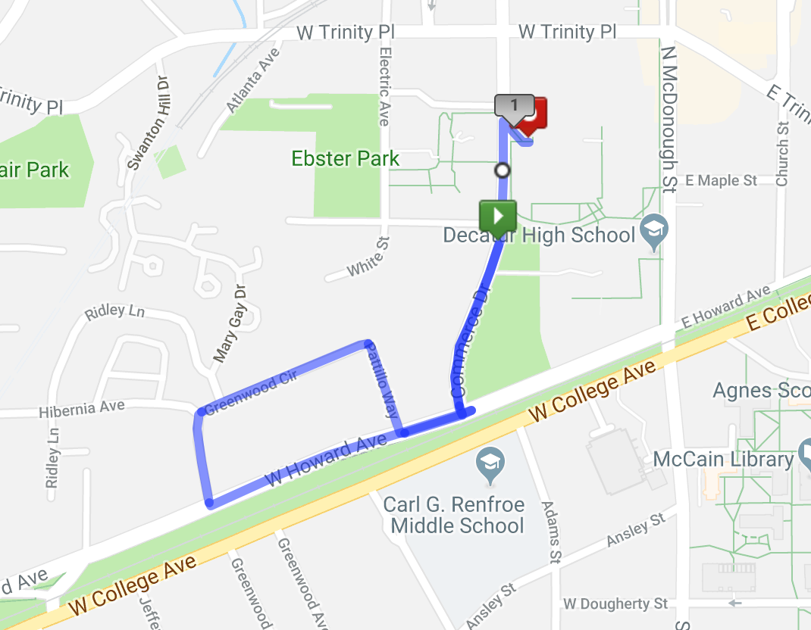
1 Mile Fun Run Map
START on COMMERCE DRIVE SOUTHBOUND (near Commerce Dr and Robin St)
RIGHT on W HOWARD AVE
RIGHT on PATTILLO WAY
LEFT on GREENWOOD CIRCLE (past Ridley Lane)
LEFT on WEST HOWARD AVE (Heading back to Decatur High School)
LEFT on COMMERCE DR
RIGHT into the DHS BACK FIELD GATE
CONTINUE TO FINISH LINE (Proceed to chute and past clocks in the middle of the ball field)

Slide 2
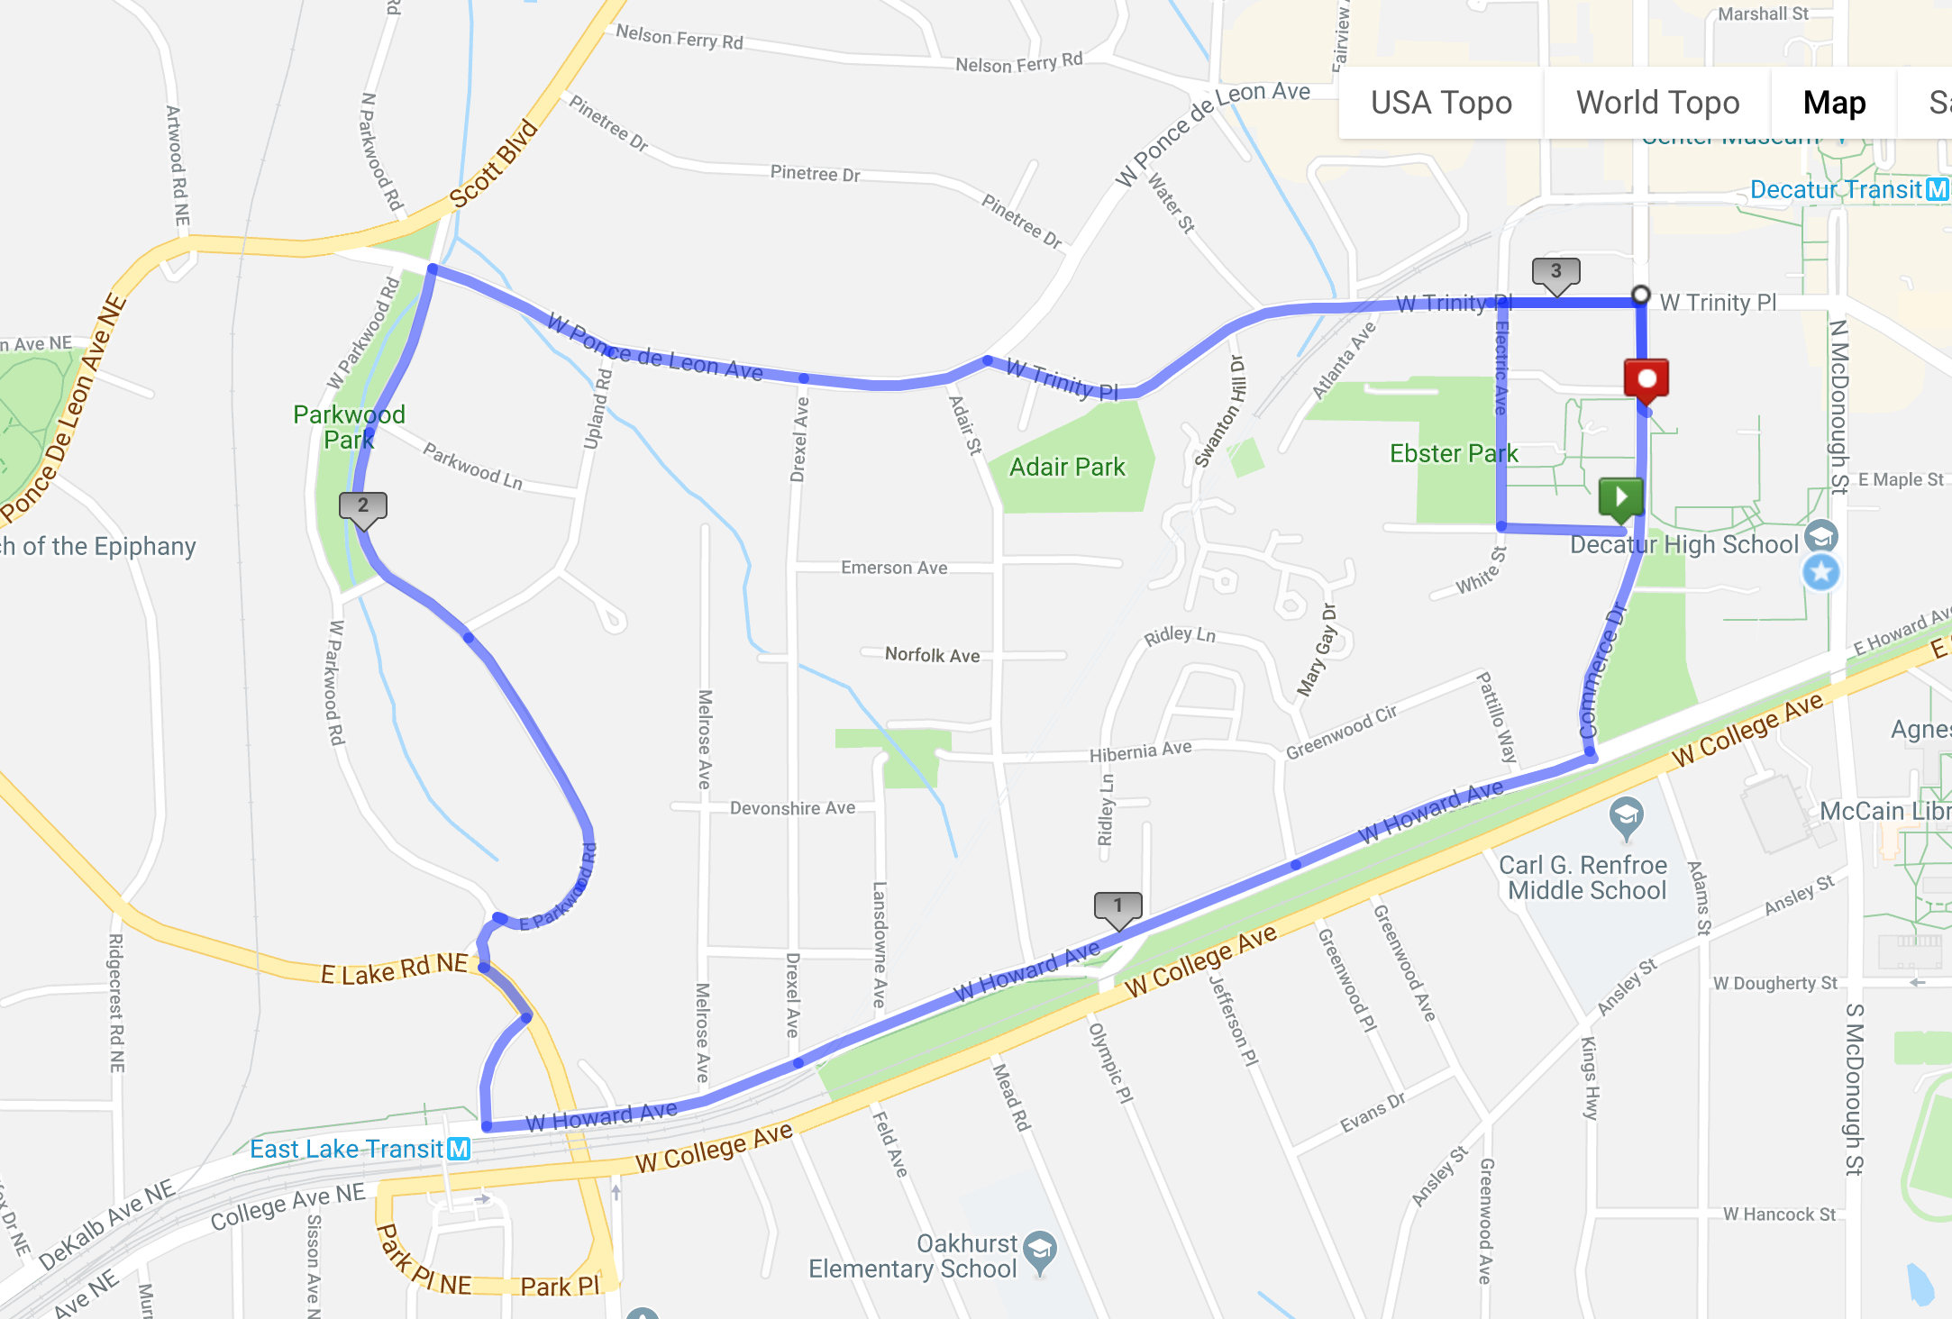
5K Road Race Map
START on COMMERCE DR SOUTHBOUND (Near Commerce Dr and Robin St)
RIGHT on ROBIN ST
RIGHT on ELECTRIC AVENUE
RIGHT on W TRINITY PL
RIGHT on COMMERCE DR
RIGHT on W HOWARD AVE
STAY STRAIGHT ON W. HOWARD TO PADEN CIRCLE
RIGHT on PADEN CIRCLE
LEFT on EAST LAKE DR
RIGHT on E PARKWOOD RD
RIGHT staying on E PARKWOOD RD
RIGHT on W PONCE de LEON AVE
RIGHT on W TRINITY PL
RIGHT on COMMERCE DR
LEFT into the DHS BACK FIELD GATE
CONTINUE TO FINISH LINE (Proceed to middle of field to finish clocks and chute to finish line)

