Slide 1
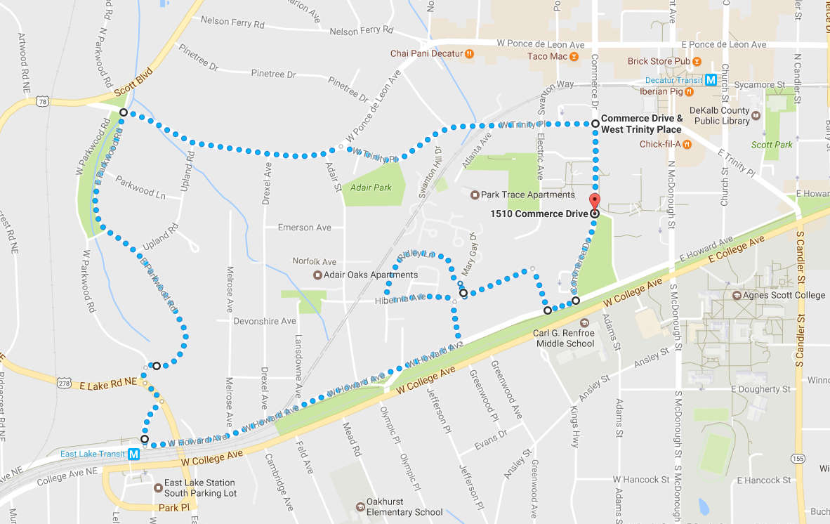
Tour deCatur 5k Course Map
Water Station
Water station location on East Parkwood Rd. near Upland Rd. intersection

