Slide 1
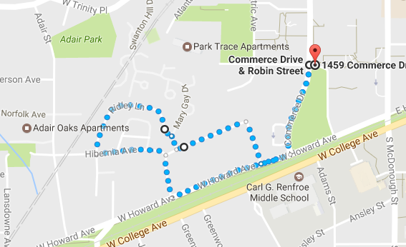
Tour deCatur 1 mile Course Map

